Slide 1




BUSNIESS INSIGT 360 - ATLIQ TECHNOLOGIES

Slide 2

PROJECT DETAILS
In this project, the goal is to create one report that could be used by stakeholders from the sales, marketing, finance, and executive teams. The focus is made on the following
1. Robust Data Modeling
2. User-empathetic Report design
3. Drillable Insights
I learned the following things in this project
1. Power Query (Basic and Advanced Operations)
2. Basic and complex DAX formulas
3. Data modelling involving 10+ tables
4. Choosing the right visuals and formatting
5. Dashboard designing principles
6. Using bookmarks
7. Deploying in Power BI service
8. Stakeholder Feedback Implementation
9. Sales, Marketing, Finance & Supply Chain metrics

Slide 3
BUSINESS OBJECTIVE
Built a Power BI dashboard to analyze AtliQ hardware's sales trends over the globe by gathering data from Excel/CSV files and a SQL database, creating a data model and visualizations in Power BI, and optimizing the report with DAX studio.
The dashboard helped AtliQ hardware understand different departments' sales trends and make data-driven decisions. This project could increase the revenue by 10% and reduce data-related expenses by 20%.

Slide 4
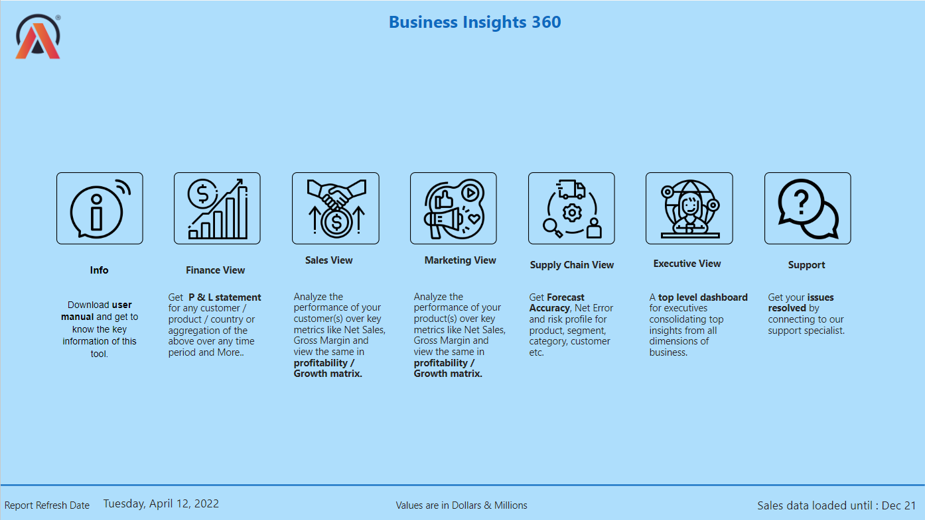
HOME PAGE

Slide 5
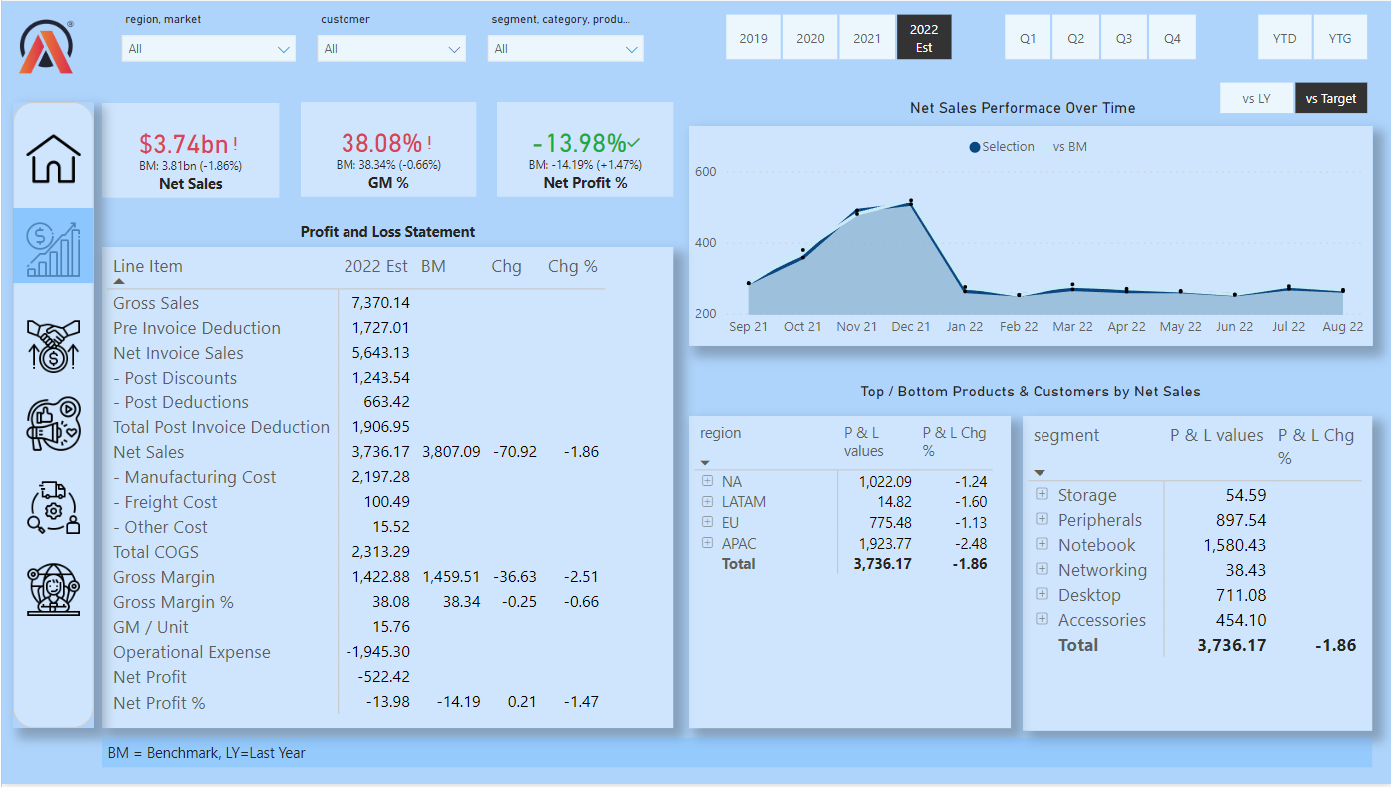
FINANCE VIEW

Slide 6
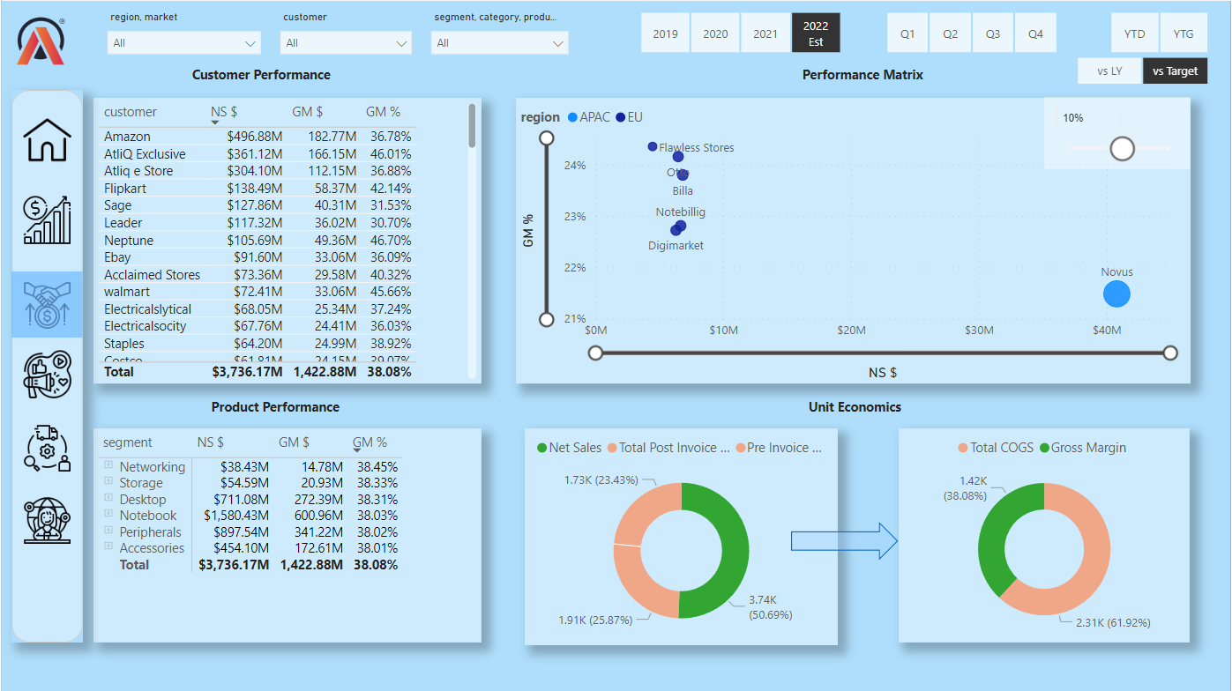
SALES VIEW

Slide 7
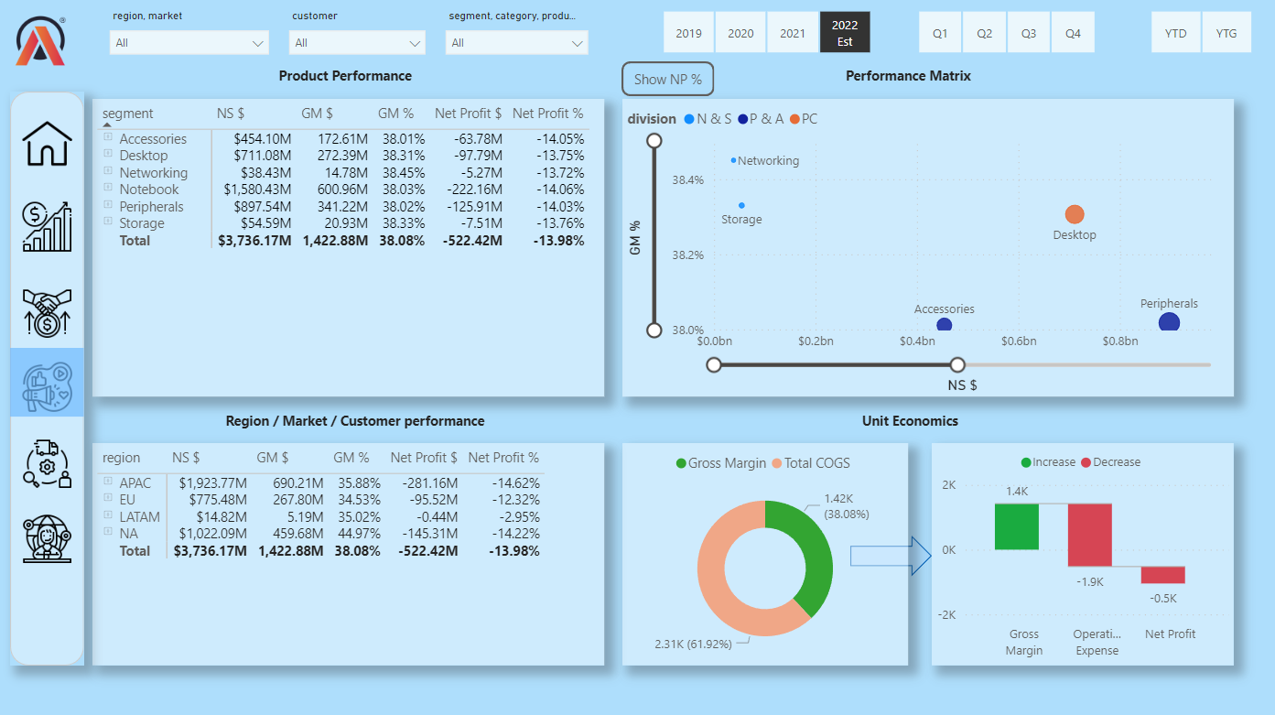
MARKETING VIEW

Slide 8
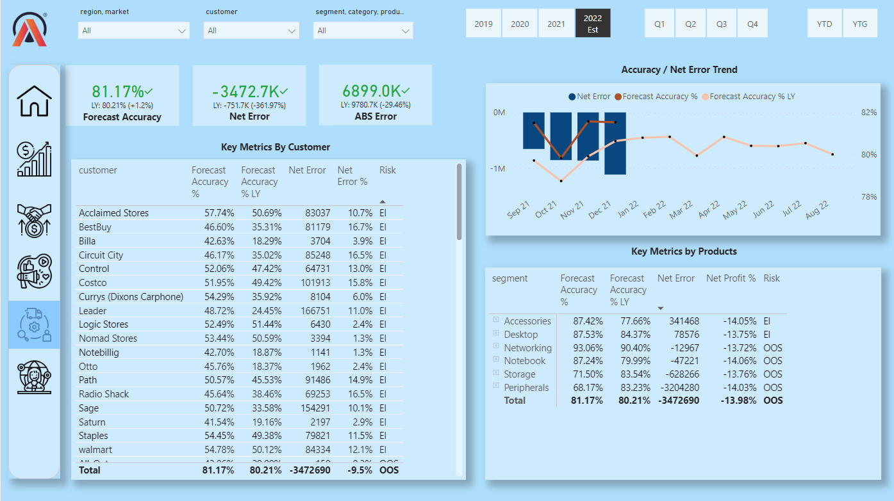
SUPPLY CHAIN VIEW

Slide 9
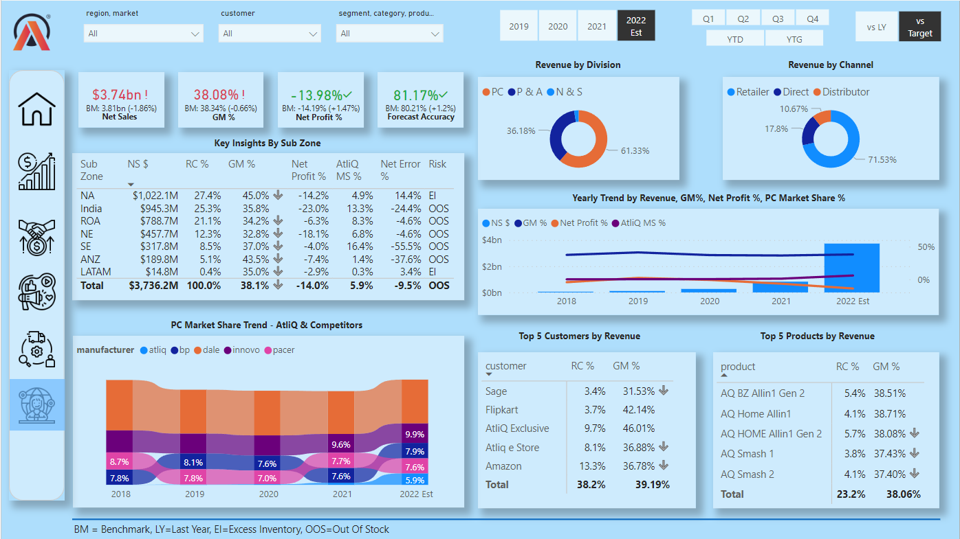
EXECUTIVE VIEW

Slide 10

THANK'S FOR READING
Mustafa - Top Rated Data Analyst

